Slide 1

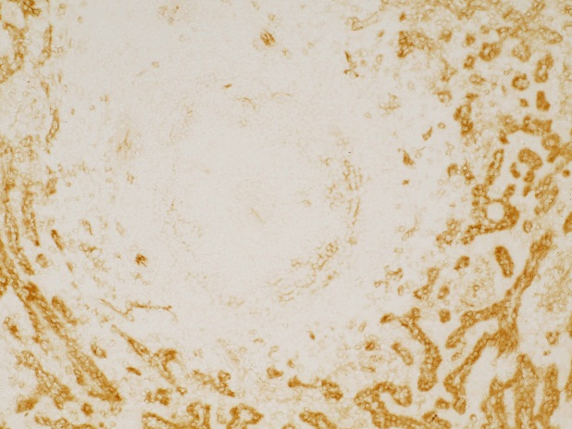
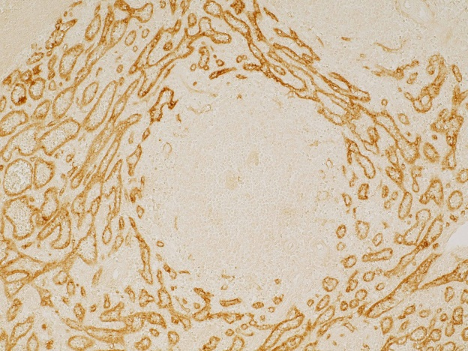
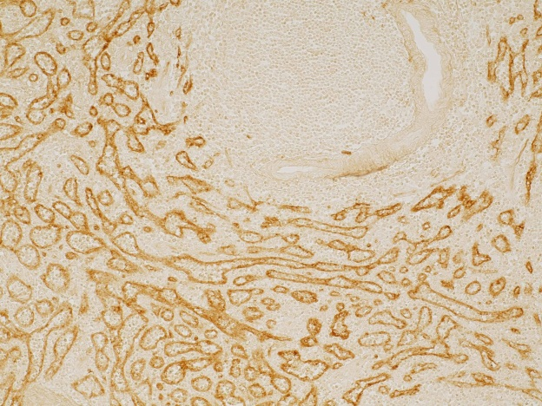
ReliaTech GmbH
Anti-human LYVE-1
(Human Spleen, Cat# 102-PA50S)
Cryo section
Anti-human LYVE-1 (Cat# 102-PA50S)
Paraffin section
Anti-human TIE-2 #tek9
Anti-human LYVE-1 (Cat# 102-PA50S)
Cryo section
Anti-human LYVE-1 (Cat# 102-PA50S)
The experiment was performed by Prof. Dr. Birte Steiniger, Institute of Anatomy and Cell Biology Robert-Koch-Str. 8, D-35037 Marburg, Germany
http://www.reliatech.de / orders@reliatech.de

